Slide 1
Causality & experiments
DS3
Brian Quistorff Jake Hofman
MSR

Slide 2
Prediction
Make a forecast, leaving the world as it is
vs.
Causation
Anticipate what will happen when you make a change in the world

Slide 3
Prediction
Make a forecast, leaving the world as it is
(seeing my neighbor with an umbrella might predict rain)
vs.
Causation
Anticipate what will happen when you make a change in the world
(but handing my neighbor an umbrella doesn’t cause rain)

Slide 4
Effect question
“What happens if we do X?”, e.g.
How does education impact future earnings?
What is the effect of advertising on sales?
How does hospitalization affect health?
John Stuart Mill (1843)

Slide 5
Example: Hospitalization on health
What’s wrong with estimating this model from observational data?
Hospital visit today
Health tomorrow
Effect?
Arrow means “X causes Y”

Slide 6
Confounds
The effect and cause might be confounded by a common cause, and be changing together as a result
Health today
Hospital visit today
Health tomorrow
Effect?
Dashed circle means “unobserved”

Slide 7
Confounds
If we only get to observe them changing together, we can’t estimate the effect of hospitalization changing alone
Health today
Hospital visit today
Health tomorrow
Effect?

Slide 8
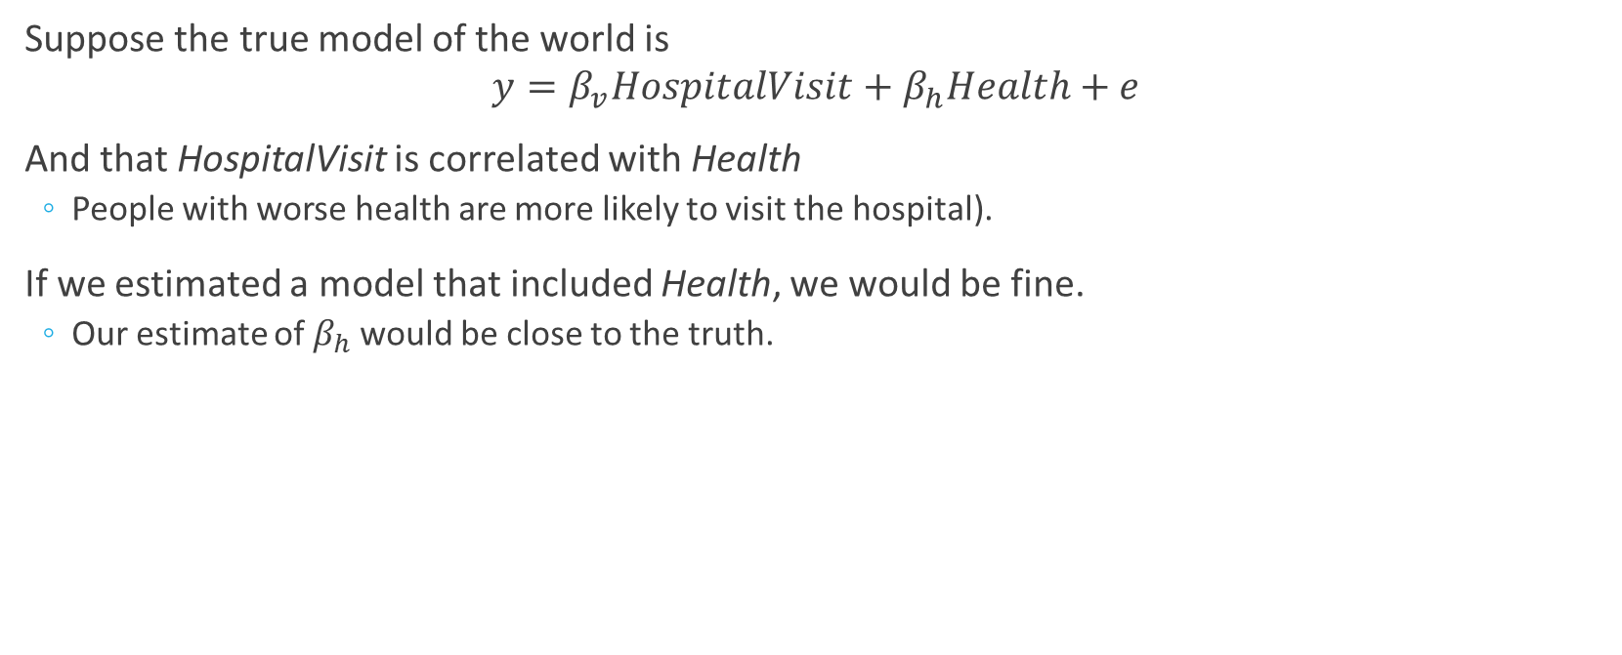
Population Equation
Suppose the true model of the world is
$$y=β_{v}HospitalVisit+β_{h}Health+e$$
And that HospitalVisit is correlated with Health
People with worse health are more likely to visit the hospital).
If we estimated a model that included Health, we would be fine.
Our estimate of $β_{h}$ would be close to the truth.

Slide 9
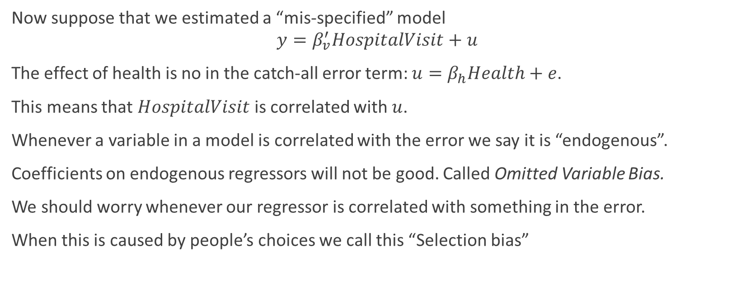
Omitted Variable Bias
Now suppose that we estimated a “mis-specified” model
$$y=β_{v}^{′}HospitalVisit+u$$
The effect of health is no in the catch-all error term: $u=β_{h}Health+e$.
This means that $HospitalVisit$ is correlated with $u$.
Whenever a variable in a model is correlated with the error we say it is “endogenous”.
Coefficients on endogenous regressors will not be good. Called Omitted Variable Bias.
We should worry whenever our regressor is correlated with something in the error.
When this is caused by people’s choices we call this “Selection bias”

Slide 10

OVB
The amount of bias in our estimate of $β_{h}$ is proportional to:
The relation between the regressor and the confounder
The relation between the confounder and the outcome.

Slide 11
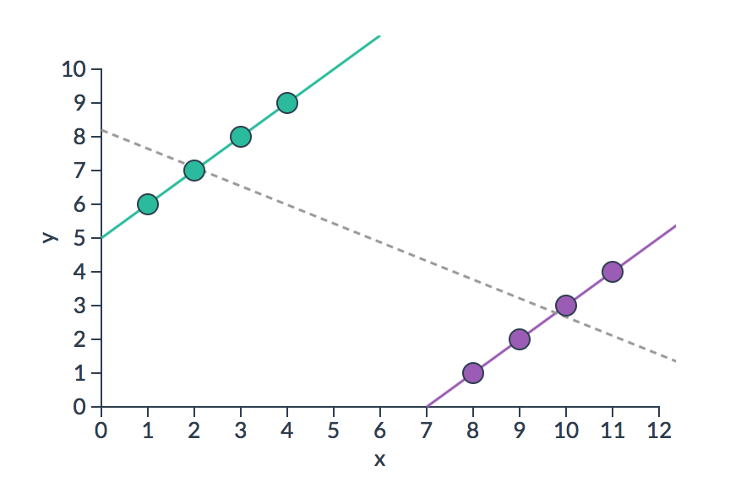
Simpson’s paradox
Selection bias can be so large that observational and causal estimates give opposite effects (e.g., going to hospitals makes you less healthy)
http://vudlab.com/simpsons

Slide 12
Simpson’s Paradox: Batting Averages
 | 1995 |  | 1996 |  | Combined
Derek Jeter | 12/48 | .250 | 183/582 | .314 | 195/630 | .310
David Justice | 104/411 | .253 | 45/140 | .321 | 149/551 | .270

Slide 13
“To find out what happens when you change something, it is necessary to change it.”
-George Box

Slide 14
Random assignment
Random assignment determines the treatment independent of any confounds
Health today
Coin flip
Hospital visit today
Health tomorrow
Effect?
Double lines mean “intervention”
Notes:
Actually all we need is a controlled assignment, not necessarily random.

Slide 15



Counterfactuals
To isolate the causal effect, we have to change one and only one thing (hospital visits), and compare outcomes
Reality
Counterfactual
+
vs
(what happened)
(what would have happened)

Slide 16
Counterfactuals
We never get to observe what would have happened if we did something else, so we have to estimate it
Reality
Counterfactual
+
vs
(what happened)
(what would have happened)
Notes:
What we’d like to do is to make a copy of the world

Slide 17


Random assignment
We can use randomization to create two groups that differ only in which treatment they receive, restoring symmetry
World 1
World 2
Heads
Tails
+

Slide 18

Random assignment
We can use randomization to create two groups that differ only in which treatment they receive, restoring symmetry
World 1
World 2
Heads
Tails
+

Slide 19
Random assignment
We can use randomization to create two groups that differ only in which treatment they receive, restoring symmetry
World 1
World 2
+

Slide 20
Basic identity of causal inference
The observed difference is now the causal effect:
Observed difference = Causal effect – Selection bias
= Causal effect
Selection bias is zero, since there’s no difference, on average, between those who were hospitalized and those who weren’t

Slide 21
Caveats / limitations
Random assignment is the “gold standard” for causal inference, but it has some limitations:
Randomization often isn’t feasible and/or ethical
Experiments are costly in terms of time and money
Inevitably people deviate from their random assignments

Slide 22
Infeasibility: What researcher can’t do
Macro-political events: wars, political leaders, large policies (e.g. trade agreements, tax policies)
Natural features: earthquakes, geography
History

Slide 23
Ethics: Abusive studies on human subjects
Nazi human experimentation – 1940s
Tuskegee syphilis experiment – 1932-1972
Human radiation experiments – Cold War
Stanford Prison Experiment – 1971
Milgram experiment – 1963
Project MKUltra – Cold War

Slide 24
Ethics: Institution Review Boards (IRBs)
Most university / research organizations have an IRB
Independent of researchers
Usually requires Informed Consent (unless very low risk and notification would hamper research)
Risks to subjects are balanced by potential benefits to society
The selection of subjects presents a fair or just distribution of risks and benefits to eligible participants
Additional Protection for Vulnerable individuals: Prisoners, Children, Pregnant women (and fetuses).
Required for government funded research or for research published in most journals

Slide 25
Ethics: Continuing Concerns
Political Science studies effects on elections (foreign and domestic)
Facebook experimenting on the happiness of people via feed changes
Avoiding foreign IRBs due to corruption concerns
Many clinical trials are done in low-income countries due to costs.

Slide 26
Ethics: Is it ethical to randomize?
If we think something is better why don’t we provide to all those in need?
Counter: It’s good to randomize when,
Over-subscription
Staggered roll-out
We often aren’t sure it’s better

Slide 27
Cost
Pharmaceutical drug clinical trials: “it’s millions, and many years, and most of them fail.”
Many of the randomized treatments are most interesting in the long-run:
Early childhood interventions
Chronic conditions

Slide 28
Contamination
Participants may drop out of an experiment. What the people doing badly preferentially leave?
Participants may switch treatments
People may behave differently if they know they are in an experiment

Slide 29
Experimental Design
What is the Treatment and what is the control? Is there a placebo?
At what level is this randomized (participant, cluster)?
What do I want to measure? Can I measure it effectively (e.g. privacy concerns)?
Blinding: Participants and experimental workers should not know whether in control or treatment?

Slide 30
Types of validity
Internal Validity
Did I correctly estimate the effect in my sample?
Did I not control for a confounder?
External Validity
Will this effect hold elsewhere?
Did I study a population that is very unique?
These answer did I learn anything potentially useful?

Slide 31
Closing thoughts
Experiments are called A/B testing in the business world and it is a new business process that is expanding very fast.

Slide 32
Closing thoughts
Large-scale observational data is useful for building predictive models of what the word has been like
But without appropriate random variation, it’s hard to predict what happens when you change something new in the world

Slide 33
Closing thoughts
Randomized experiments are like custom-made datasets to answer a specific question

Slide 34

Statistical Review
Significance level, $α$ (e.g. 5%): Chance of getting Type I Error if Effect Doesn’t Exist (first column)
Statistical Power: Chance of Detecting Effect when it does exist (second column)
 | Effect Doesn’t Exists | Effect Exist
Detect Effect | Type I Error (False Positive) | True Positive
Don’t Detect Effect | True Negative | Type II Error (False Negative)

Slide 35
Visualizations
Cohen’s d: http://rpsychologist.com/d3/cohend/
Power & Statistical Significance: http://rpsychologist.com/d3/NHST/

Slide 36
Appendix

Slide 37

Types of Estimates
Desire/Selection (D):
D=1: Went=Went to Hospital
D=0: Stayed=Stayed at Home
Treatment (W):
W=1: Treated=Hospital Care
W=0: Untreated=No Hospital Care
Health: $H$

Slide 38

Types of Estimates
Average Treatment Effect: Difference in Health between being treated and not.
$$ATE=E[H_{Treated}−H_{Untreated}]$$
Average Treatment Effect on the Treated: Difference in Health between being treated and not given they tried to get treatment.
$$ATT=E[H_{Treated}−H_{Untreated}|Went]$$

Slide 39

$$Δ_{obs}=E\left[H | Went\right]−E\left[H | Stayed\right]$$
$$=E\left[H_{Treated} | Went\right]−E\left[H_{Untreated} | Stayed\right]$$
$$=E\left[H_{Treated} | Went\right]−E\left[H_{Untreated} | Went\right]+$$
$$E\left[H_{Untreated} | Went\right]−E\left[H_{Untreated} | Stayed\right]$$
$$=ATT+Selection$$

Slide 40
Observational estimates
Δ_{obs} = (Health | Went) – (Health |Stayed)
Δ_{obs} = (Health if Treated | Went) – (Health if Untreated |Stayed)
Δ_{obs} = (Health if Treated | Went) – (Health if Untreated | Went)+
(Health if Untreated | Went) – (Health if Untreated |Stayed)
Δ_{obs} = ATET + Selection

